Slide 1
FY 2023 NSGP Process Overview for SAAs
Grant Programs Directorate
Federal Emergency Management Agency
Notes:
Title slide + Image Option 2

Slide 2








Table of Contents
1. Key Info for FY 2023 & Grants.gov File Names
2. Available Processes & Next Steps
3. Export Process Terminology
4. Suggested Export Process Map
5. Export Process Instructions
6. Migration Process Instructions
7. Export & Migration Process Recap
8. Scoring Matrix

Slide 3
Key Info for FY 2023

Slide 4
Key Info for Fiscal Year (FY) 2023
All required files are available on Grants.gov. Make sure to download the FY 2023 versions!
The Investment Justification template required by FEMA is a PDF file, updated annually. Templates from prior years are not accepted. The PDF file provides the option for data export. The export process is not required but is fully detailed later in this document for any State Administrative Agency (SAA) that chooses to use it.
The State Administrative Agency (SAA) Prioritization Tracker is still a required file, but it has been updated. The FY 2023 Prioritization Tracker should be used. Trackers from prior years are no longer accepted.
The scoring criteria have been updated for FY 2023 to ensure clarity and alignment. The FY 2023 Scoring Tool and FY 2023 Scoring Matrix both show these updates. Scoring tools from prior years are no longer accepted.
As in prior years, SAAs are only required to submit Investment Justifications and Prioritization Trackers to FEMA. All other documentation is intended to serve as an aid or reference to make the process of reviewing, scoring, and submitting to FEMA more streamlined.

Slide 5
File Names on Grants.gov
Files that will be submitted to FEMA
Investment Justification (IJ): FY_2023_NSGP_Investment Justification
SAA Prioritization Tracker for NSGP-S: FY_2023_NSGP-S_Prioritization of Investment Justifications
SAA Prioritization Tracker for NSGP-UA: FY_2023_NSGP-UA_Prioritization of Investment Justifications
Files not submitted to FEMA, but available for SAA use/reference
Scoring Tool: FY_2023_Scoring Tool_ONLY
NSGP IJ Export Assistance Data Collection & Cleaning Tool: FY_2023_NSGP_Export Assistance and Data Collection Cleaning Tool
NSGP Process Overview for SAAs: FY_2023_NSGP_Process Overview for SAAs (*this file*)
NSGP Scoring Matrix: FY_2023_NSGP_Scoring Matrix (*included at the end of this file*)

Slide 6
Available Processes and Next Steps

Slide 7
Available Processes
The process used to collect, score, and prioritize Investment Justifications (IJs) is up to the SAA. Neither will be given preference by FEMA and are only being provided for the convenience of the SAAs.
Manual Copy and Paste
PDF Export Process
This process is the same as previous years.
Open each Investment Justification and individually copy and paste the requested information from the nonprofit’s Investment Justification into the SAA Prioritization Tracker.
Export all Investment Justification content from multiple PDFs into a single Excel spreadsheet.
Use the NSGP IJ Export Assistance Data Collection & Cleaning Tool to automatically create a table of information you can copy and paste into your SAA Prioritization Tracker.

Slide 8
Next Steps
The process used to collect, score, and prioritize IJs is up to the SAA.
Neither will be given preference by FEMA and are only being provided for the convenience of the SAAs.
Manual Copy and Paste
PDF Export Process
Skip to the Scoring Matrix for your reference and proceed as you did in previous years.
Review and score each Investment Justification.
Fill out the Prioritization Tracker.
Save the Prioritization Tracker. Submit the completed Prioritization Tracker and the Investment Justifications to FEMA in ND Grants.
Follow the processes outlined in the next slides to:
Export all Investment Justification content from multiple PDFs into a single Excel spreadsheet.
Use the NSGP IJ Export Assistance Data Collection & Cleaning Tool to automatically create a table of information you can copy and paste into your SAA Prioritization Tracker.
Save the Prioritization Tracker. Submit the completed Prioritization Tracker and the Investment Justifications to FEMA in ND Grants.

Slide 9
Export Process Terminology

Slide 10
Terminology
Investment Justification (IJ): The IJ is the only portion of a nonprofit’s application package that will be provided to and reviewed by FEMA. For FY 2023, this form is an updated PDF template (as opposed to the previous Excel & PDF versions). This will allow for better data collection for both the SAA and FEMA and will be more accessible for users with assistive devices.
Export Process: The added benefit of the PDF IJ template is that all entered information can be easily retrieved from the template(s) with one automated export process. This export process refers to the steps SAAs will take to retrieve all provided data from all IJs. The end result of the export process is an Excel file.
Export File: The export file refers to the Excel document that your computer will automatically created create as a result of the export process. This file contains raw data from ALL available fields in the IJ. It is not submitted to FEMA, but the provided NSGP IJ Export Assistance Data Collection & Cleaning Tool will transform this raw data into usable information you will eventually send to FEMA in the SAA Prioritization Tracker.
NSGP IJ Export Assistance Data Collection & Cleaning Tool: This file is not required material. It was developed specifically for the NSGP process to take the raw data from the export file and automatically transform it into the format and order required on the SAA Prioritization Tracker. It is intended to significantly reduce the administrative burden faced by the SAAs. This file does have a built-in scoring tool if SAAs choose to use it, but it is not required.
Migration Process: This refers to the process of copying the exported data from Investment Justifications into the SAA Prioritization Tracker.
SAA Prioritization Tracker: The SAA Prioritization Tracker is an Excel document provided to the SAAs by FEMA to record all submitted Investment Justifications. It will be submitted to FEMA and is the basis for the federal review process. If you are applying to both the State and Urban Area funding streams, you must have a separate prioritization tracker for each.

Slide 11
Suggested Export Process Map

Slide 12
Suggested Export Process Map for SAAs
Please note: The Export Process and SAA Review are interchangeable based on the preference of the SAA.
IJ Submissions
Nonprofits submit completed application packages to SAAs.
Export Process
SAAs will collect all submitted IJs and conduct the Export Process.
SAA Review
SAAs will conduct their review and scoring processes.
SAA Prioritization Tracker
Data from the export, paired with the SAA’s review of IJs, will be entered into the SAA Prioritization Tracker.
Submission to FEMA
SAA submits the Prioritization Tracker and IJs to FEMA via ND Grants.
Note: This is where the export file will be created.
Note: SAAs can utilize the NSGP IJ Export Assistance Data Collection & Cleaning Tool here to format data in a manner more conducive to reviewing and/or scoring IJs in the excel document.
Note: SAAs may choose to use the NSGP IJ Export Assistance Data Collection & Cleaning Tool to help conduct their scoring/review process if desired.

Slide 13
Detailed Export Process
Please note: if you do not want/need detailed instructions for the export and migration processes, click here for a brief overview. This process is the same from FY22 to FY23.

Slide 14
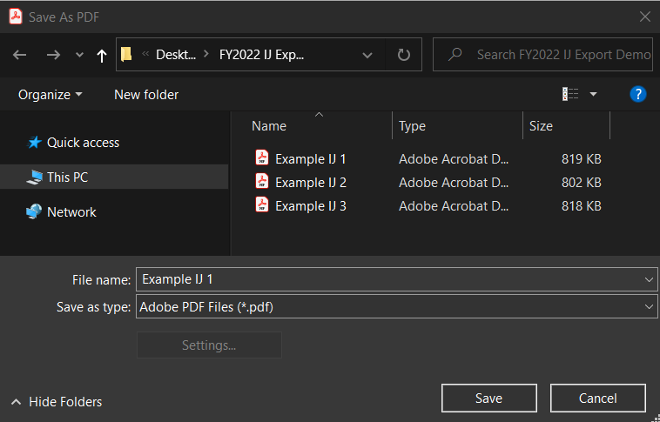
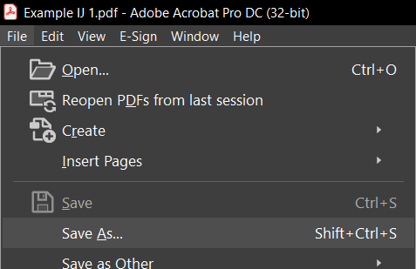
Export Process: Step 1
1. All IJs should be saved as PDFs. Confirm that all IJs are saved as PDFs and use the Save As function if they are not. The export function will only work with PDFs.

Slide 15
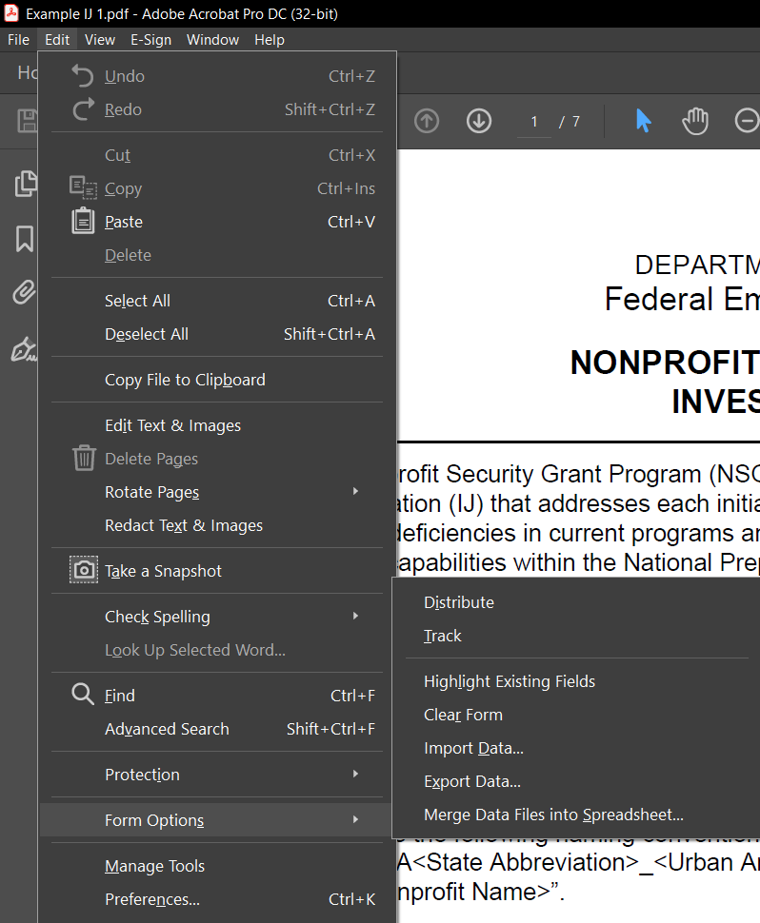
Export Process: Step 2
2. Open one file and click Edit > Form Options > Export Data…
Please note: this is just for the beginning of the export process – you will not have to do each of the steps that follow for every individual IJ PDF.

Slide 16
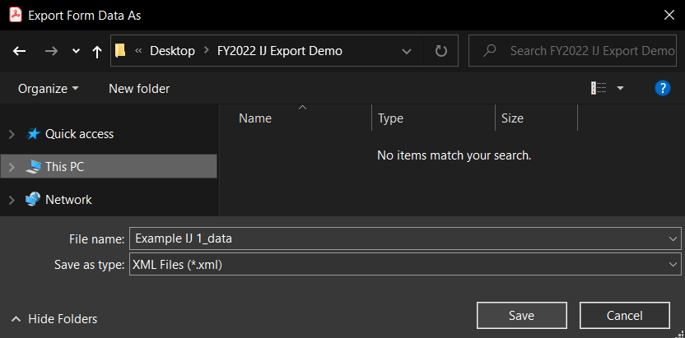
Export Process: Steps 3 & 4
3. Enter the file name to save the open file as
Please note: Files in this demo use “Example IJ” to designate that this is an example. Please ensure that all of your files use the required NSGP naming conventions as listed in the program documentation (IJ, NOFO).
NSGP-S: FY2022_NSGP_S_<State
Abbreviation>_<Nonprofit Name>
NSGP-UA: FY2022_NSGP_UA_<State Abbreviation>_<Urban Area>_<Nonprofit Name>
4. Click Save

Slide 17

Export Process: Step 5
5. Once saved, click Edit > Form Options > Merge Data Files into Spreadsheet

Slide 18
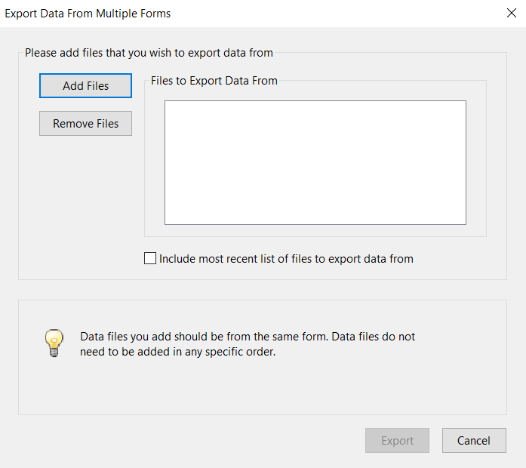
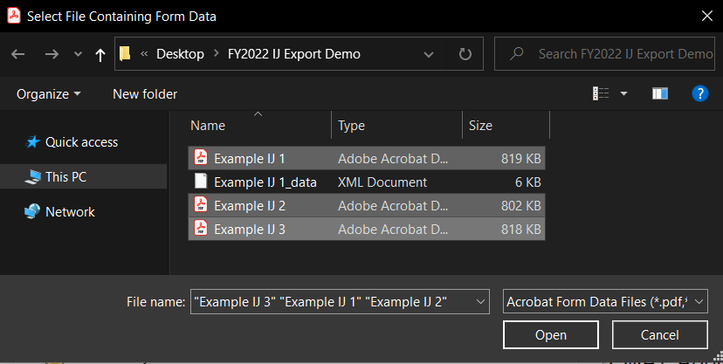
Export Process: Steps 6 & 7
6. Once the dialog box opens, click “Add Files” and select all the PDF ONLY files that need to be included. (This should include all IJs, regardless of whether they will be recommended to FEMA.)
7. Use the “CTRL” function to select multiple files and click “Open” once all necessary files are selected.

Slide 19
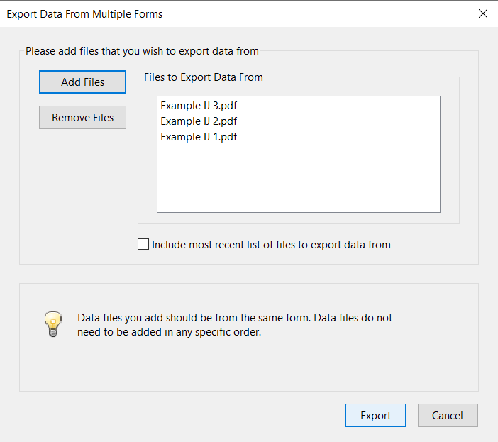
Export Process: Step 8
8. Click “Export”
Reminder: The files listed in this step should only be the PDF IJ files, NOT the XML versions!

Slide 20
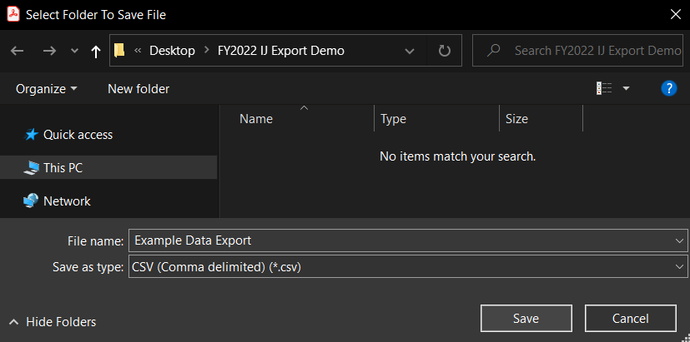
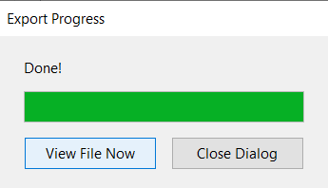
Export Process: Steps 9 & 10
9. When the dialog box opens, enter the file name for the report (all the export data) and click save.
10. Click “View File Now”

Slide 21
Export Result
When you open the Excel file you just saved in the previous step, this is how it will be structured.
The information contained is raw data from the IJ(s) and the headings use coding from the PDF template.
The following slides will help convert this raw data into more usable formatting and headers.

Slide 22
Migration Process

Slide 23
Migration Process
If you want to preserve a copy of the original exported report, save a copy now.
However, you do not have to preserve this file. It can be recreated if needed at any time!
When the report opens, the following columns will align to the information requested in the Prioritization Tracker:
There are multiple methods you can use to transfer this information from the export file into the SAA Prioritization Tracker. Those methods are detailed in the following slides.
B – Organization Name
C, D, E, F (Combined) – Address
N – Nonprofit Organization Category
O – Organization Category, if “Other”
P – Organization Function
Q – Organization Affiliation
R – Affiliation, if “Other”
U – UEI Number
W – Urban Area (if applicable)
X – Total Federal Funding Requested
CR, CS – Prior Funding Received

Slide 24
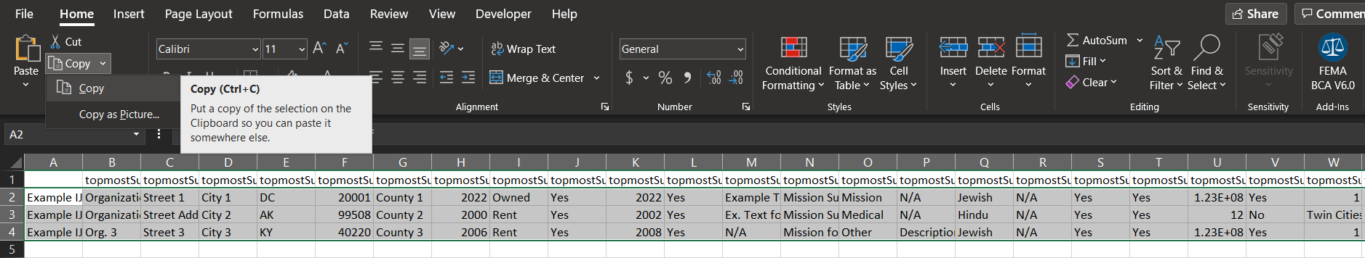
Migration Process
Using the NSGP IJ Export Assistance Data Collection & Cleaning Tool
A. Insert Data
Select ALL data provided by the export file. You can do this by clicking cell A2 and then, before releasing the button on your mouse, drag your cursor to the end of your data (Column CZ, Row __).
  Do not select the column headers.
  Remember that the number of rows of data is based on the number of Investment Justifications included.
Copy the selection.
NOTE: Select the full data range of cells, but do not select the full row. (i.e., do not click “B” to highlight all of row B).

Slide 25
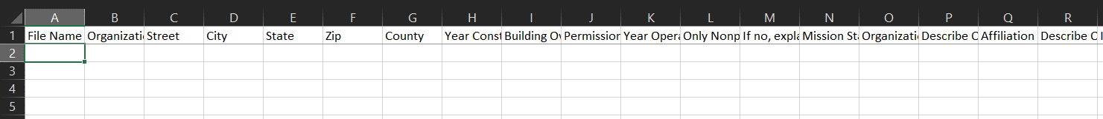
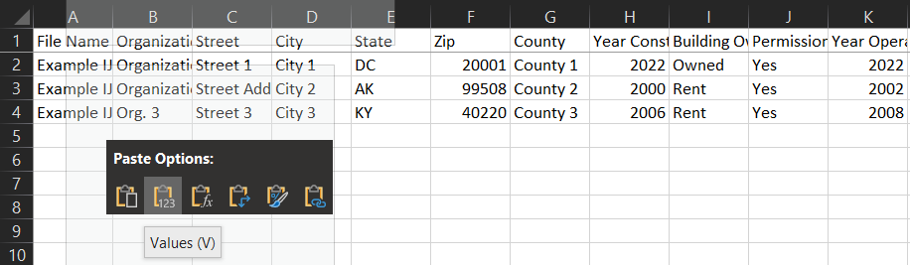
Migration Process
Using the NSGP IJ Export Assistance Data Collection & Cleaning Tool
B. Copy Data
In the Export Assistance file, on the tab labeled “Paste Initial Data Here,” put your cursor in the first blank cell (A2).
Note: The headers in this table will now be more conducive to reviewing/understanding the data.
After you have copied your data and clicked on cell A2, you can right click with your mouse. Select the “Values (V)” option under Paste. Be sure to paste values only!

Slide 26
Migration Process
Using the NSGP IJ Export Assistance Data Collection & Cleaning Tool
C. Review file for use in SAA Prioritization Tracker
In the Export Assistance file, select the tab named “Copy into SAA Prioritization.”
  The display below demonstrates how the data is transformed and ordered to align with the SAA Prioritization tracker. This will allow you to retrieve all information from the IJs and quickly transfer all data into your tracker file for submission to FEMA without having to do any manual data cleaning.
Tip: Based on Excel formatting, sometimes a “0” may show up in cell if you paste data and that cell is empty. Having a zero show up in an otherwise empty cell is not a problem, as long as it is not providing inaccurate data. You should be able to delete or type over these zeroes when/where needed.

Slide 27
Migration Process
Using the NSGP IJ Export Assistance Data Collection & Cleaning Tool
D. Copy information into the SAA Prioritization Tracker
Select the data from the tab labeled “Copy into SAA Prioritization” in the same way you selected data in the prior steps. Remember not to select the column headers!
If you are importing data for NSGP-S, select cell B2 and Paste values in the same way you did in step 4.
  Note: You will paste into cell B2 of the SAA Prioritization Tracker because cell A2 should list the applying state.
If you are importing data for NSGP-UA, select cell C2 and Paste values in the same way you did in step 4.
  Note: You will paste into cell C2 of the SAA Prioritization Tracker because cell A2 should list the applying state and cell B2 should list the applying Urban Area.
Columns with a yellow header in this spreadsheet indicate the answers you will have to provide manually in the SAA Prioritization Tracker.

Slide 28
Migration Process
NOT USING the NSGP IJ Export Assistance Data Collection
& Cleaning Tool
Copy & Paste without Deleting
Copy & Paste with Deleting
Choosing to retain all of the exported information in the spreadsheet will make the copy and paste transfer process more time-consuming, but it will allow the SAA to have all IJ responses compiled into a single file if that leads to ease of review.
Choosing to delete the extraneous columns will make the copy and paste transfer process quicker, but will then require each IJ to be opened for review.
Federal Emergency Management Agency
28

Slide 29
Migration Process
NOT USING the NSGP IJ Export Assistance Data Collection
& Cleaning Tool
Copy & Paste without Deleting
Copy & Paste with Deleting
Select only the information that corresponds to the requested information in the State Prioritization Tracker.
Copy cells and paste information into the State Prioritization Tracker.
Verify that the information has been migrated correctly, as this will impact the review process.
Delete the columns that do not correspond to requested information in the State Prioritization Tracker.
  The columns that can be deleted (as they exist in the original file) are: A, G, H, I, J, K, L, M, S, U, V, W, Y, Z, AA, AB, AC, AD, AE, AF, AG, AH, AI, AJ, AK, AL, AM, AN, AO, AP, AQ, AR, AS, AT, AU, AV, AW, AX, AY, AZ, BA, BB, BC, BD, BE, BF, BG, BH, BI, BJ, BK, BL, BM, BN, BO, BP, BQ, BR, BS, BT, BU, BV, BW, BX, BY, BZ, CA, CB, CC, CD, CE, CF, CG, CH, CI, CJ, CK, CL, CM, CN, CO, CP, CQ, CT, CU, CV, CW, CX, CY, CZ
Select all remaining information on the spreadsheet.
Copy cells and paste information into the State Prioritization Tracker.
Verify that the information has been migrated correctly, as this will impact the review process
NOTE: Hidden rows/columns will still be copy and pasted if part of the selection.
Federal Emergency Management Agency
29

Slide 30
Export and Migration Recap

Slide 31
Recap
Export
Ensure all IJs are PDFs.
With one IJ open, select Edit > Form Options > Export Data
Use “Save as” to enter a file name and save
With one IJ open, select Edit > Form Options > Merge Data Files into Spreadsheet
Add Files > Select all PDF IJ files > Open
Export > Save > View File Now
Migration
Open NSGP IJ Export Assistance Data Collection & Cleaning Tool to the tab labeled “Paste Initial Data Here”
Select all data (do not select headers) in the Export File created above and copy
Select cell A2 in NSGP IJ Export Assistance Data Collection & Cleaning Tool and paste values
Use Scoring Tool tab in NSGP IJ Export Assistance Data Collection & Cleaning Tool if desired
Select “Copy into SAA Prioritization Tracker” tab
Select all data (do not select headers) in the “Copy into SAA Prioritization Tracker” tab
Paste values into SAA Prioritization Tracker

Slide 32
Scoring Matrix

Slide 33
Nonprofit Security Grant Program Scoring Matrix
Reviewers should use this document as a reference when scoring applications under the Nonprofit Security Grant Program (NSGP).
I – Applicant Information
Question |  | Criteria | Score | Explanations
1 | Did the applicant provide all the required information in the Applicant Information Section? | The applicant should provide all information as it is applicable in the informational section. | Yes | The applicant did provide all the required information.
 |  |  | No | The applicant did not provide all the required information.
II - Background
Question |  | Criteria | Score | Explanations
2 | Did the applicant provide a description of their nonprofit organization to include symbolic value of the site as a highly recognized national or historical institution or as a significant institution within the community that renders the site as a possible target of terrorism and other extremist attacks? | Applicants must describe their organization, its mission/purpose, the symbolic value of the building/organization, and how these factors may make it the target of an attack. | 0 | The applicant did not provide a description of the organization including the symbolic value of the site as a highly recognized institution that renders the site a possible target of terrorism or other extremist attacks.
 |  |  | 1 | The applicant provided a poor description of the organization including the symbolic value of the site as a highly recognized institution that renders the site a possible target of terrorism or other extremist attacks.
 |  |  | 2 | The applicant provided an adequate description of the organization including the symbolic value of the site as a highly recognized institution that renders the site a possible target of terrorism or other extremist attacks.
 |  |  | 3 | The applicant provided a full, clear, and effective description of the organization including the symbolic value of the site as a highly recognized institution that renders the site a possible target of terrorism or other extremist attacks.
3 | Did the applicant provide a description of their nonprofit organization to include any role in responding to or recovering from events that integrate nonprofit preparedness with broader state/local preparedness efforts? | Applicants must clearly describe their individual organization’s previous or existing role in response to or in recovery efforts to terrorist or other extremist attacks. This should tie into the broader preparedness efforts of state and/or local government. | 0 | The applicant did not provide a description of the organization that included any role in responding to or recovering from events that integrate nonprofit preparedness with broader state/local efforts.
 |  |  | 1 | The applicant provided some description of the organization that included any role in responding to or recovering from events that integrate nonprofit preparedness with broader state/local efforts.
 |  |  | 2 | The applicant provided a full, clear, and effective description of the organization that included any role in responding to or recovering from events that integrate nonprofit preparedness with broader state/local efforts.

Slide 34
III - Risk
Question |  | Criteria | Score | Explanations
4 | Did the applicant discuss specific threats or attacks against the nonprofit organization or closely related organization? | To substantiate the applicant’s risk to a terrorist or other extremist attack, applicants may describe incidents that have occurred at or threats that have been made to their organization. Applicants may also draw from incidents that have occurred at closely related/similar organizations either domestically or internationally; the applicant should make the connection that they are at risk for the same reasons. Local crimes such as burglary, theft, or vandalism without a terrorism, extremism, or hate-related nexus may provide context justification for NSGP funding. | 0 | The applicant did not discuss specific threats or attacks against the organization or a closely related organization.
 |  |  | 1 | The applicant provided minimal discussion of threats or attacks against the organization or a closely related organization.
 |  |  | 2 | The applicant provided poor discussion of threats or attacks against the organization or a closely related organization.
 |  |  | 3 | The applicant provided adequate discussion of threats or attacks against the organization or a closely related organization.
 |  |  | 4 | The applicant provided good discussion of threats or attacks against the organization or a closely related organization.
 |  |  | 5 | The applicant provided multiple, detailed, and specific threats or attacks against the organization or a closely related organization.
5 | In considering vulnerabilities, how well did the applicant describe the organization's susceptibility to destruction, incapacitation, or exploitation by a terrorist or other extremist attack? | Applicants must provide a clear description of findings from a completed vulnerability assessment. | 0 | The applicant did not discuss or describe the organization’s susceptibility to attack.
 |  |  | 1 | The applicant provided minimal description of the organization’s susceptibility to attack.
 |  |  | 2 | The applicant provided poor description of the organization’s susceptibility to attack.
 |  |  | 3 | The applicant provided adequate description of the organization’s susceptibility to attack.
 |  |  | 4 | The applicant provided good description of the organization’s susceptibility to attack.
 |  |  | 5 | The applicant provided clear, relevant, and compelling description of the organization’s susceptibility.
6 | In considering potential consequences, how well did the applicant address potential negative effects on the organization's asset, system, and/or network if damaged, destroyed, or disrupted by a terrorist or other extremist attack? | Applicants should describe how an attack would impact them, the community served, and if possible/applicable, beyond the immediate individuals served (nearby critical infrastructure, businesses, transportation, schools, etc.). | 0 | The applicant did not discuss or describe the potential negative consequences the organization may face.
 |  |  | 1 | The applicant provided minimal description of the potential negative consequences the organization may face.
 |  |  | 2 | The applicant provided poor description of the potential negative consequences the organization may face.
 |  |  | 3 | The applicant provided adequate description of the potential negative consequences the organization may face.
 |  |  | 4 | The applicant provided good description of the potential negative consequences the organization may face.
 |  |  | 5 | The applicant provided a clear, relevant, and compelling description of the potential negative consequences the organization may face.

Slide 35
IV – Facility Hardening
Question |  | Criteria | Score | Explanations
7 | How well does the applicant describe the proposed facility hardening activities, projects, and/or equipment and relate their proposals to the vulnerabilities described in Question 6? | In narrative form in Section IV-A, applicants must clearly explain what the proposed activities, projects, and/or equipment are, identify their estimated cost, and describe how they will mitigate or address vulnerabilities identified in the vulnerability assessment in Section III (Question 6). | 0 | The applicant did not propose facility hardening or the proposals do not mitigate identified risk(s) and/or vulnerabilities.
 |  |  | 1 | Proposed activities, projects, or equipment may provide minimal facility hardening or are only minimally related to some of the identified risk(s) and/or vulnerabilities.
 |  |  | 2 | Proposed facility hardening activities, projects, or equipment would likely mitigate identified risk(s) and/or vulnerabilities.
 |  |  | 3 | Proposed facility hardening activities, projects, or equipment are clearly aligned with and effectively mitigate the identified risk(s) and/or vulnerabilities.
8 | Did the applicant's proposed facility hardening activity focus on the prevention of and/or protection against the risk of a terrorist or other extremist attack? | The proposed activities, projects, and equipment should directly tie to the prevention of and/or protection against the risk of terrorist or other extremist attacks. | 0 | The proposed facility hardening activities do not focus on the prevention of and/or protection against the risk of terrorist or other extremist attacks.
 |  |  | 1 | The proposed facility hardening activities are somewhat focused on the prevention of and/or protection against the risk of terrorist or other extremist attacks.
 |  |  | 2 | The proposed facility hardening activities are adequately focused on the prevention of and/or protection against the risk of terrorist or other extremist attacks.
 |  |  | 3 | The proposed facility hardening activities are clearly and effectively focused on the prevention of and/or protection against the risk of terrorist or other extremist attacks.
9 | Are all proposed equipment, activities, and/or projects tied to a vulnerability that it could reasonably address/mitigate? | The proposed equipment, activities, and/or projects should mitigate/address the vulnerability tied to it in the Section IV-B table. | 0 | No vulnerabilities are listed and/or the proposed equipment, activities, or projects do not address listed vulnerabilities.
 |  |  | 1 | The proposed equipment/activities/projects are somewhat reasonable to address the listed vulnerability.
 |  |  | 2 | The proposed equipment/activities/projects are mostly reasonable to address the listed vulnerability.
 |  |  | 3 | The proposed equipment/activities/projects effectively address the listed vulnerability.

Slide 36
V – Milestones
Question |  | Criteria | Score | Explanations
10 | How well did the applicant describe the milestones and the associated key activities that lead to the milestone event over the NSGP period of performance? | The applicant should describe the milestones needed to accomplish the goals of the NSGP funding and should include the key activities that will be necessary to accomplish those milestones. | 0 | The applicant did not provide information on milestones and associated key activities.
 |  |  | 1 | The applicant provided some description of milestone events and the associated key activities over the NSGP POP.
 |  |  | 2 | The applicant provided adequate description of milestone events and the associated key activities over the NSGP POP.
 |  |  | 3 | The applicant fully and effectively described milestone events and the associated key activities over the NSGP POP.
11 | Did the applicant include milestones and associated key activities that are feasible over the NSGP period of performance? | Milestones should be realistic, potentially include the entire period of performance (36 mo.), be inclusive of all proposed activities, and consider the Environmental Planning and Historic Preservation review process. Milestones should not exceed 36 months and should not begin prior to the Period of Performance. | 0 | The applicant did not include milestones and key activities that are feasible over the NSGP POP.
 |  |  | 1 | The applicant included milestones and key activities that are somewhat feasible over the NSGP POP.
 |  |  | 2 | The applicant included milestones and key activities that are feasible over the NSGP POP.
VI – Project Management
Question |  | Criteria | Score | Explanations
12 | How well did the applicant justify the effectiveness of the proposed management team's roles and responsibilities and the governance structure to support implementation of the Investment? | Brief description of the project manager(s) and level of experience. | 0 | The applicant did not justify the effectiveness of proposed management team or the structure in place to support implementation.
 |  |  | 1 | The applicant somewhat justified the effectiveness of the proposed management team and the structure in place to the support implementation.
 |  |  | 2 | The applicant fully justified the effectiveness of the proposed management team and the structure in place to the support implementation.

Slide 37
VII – Impact
Question |  | Criteria | Score | Explanations
13 | How well did the applicant describe the outcomes/outputs that would indicate that the Investment was successful? | Measurable outputs and outcomes should directly link to the vulnerabilities and consequences outlined in Section III. | 0 | The applicant did not describe the outcomes and/or outputs that would indicate the Investment was successful.
 |  |  | 1 | The applicant provided minimal information on the outcomes and/or outputs that would indicate the Investment was successful.
 |  |  | 2 | The applicant provided some information on the outcomes and/or outputs that would indicate the Investment was successful.
 |  |  | 3 | The applicant provided an adequate discussion of the outcomes and/or outputs that would indicate the Investment was successful.
 |  |  | 4 | The applicant provided a full and detailed description of the outcomes and/or outputs that would indicate the Investment was successful.

Slide 38
If you have questions or need assistance, please email
FEMA-NSGP@fema.dhs.gov

